Slide 1
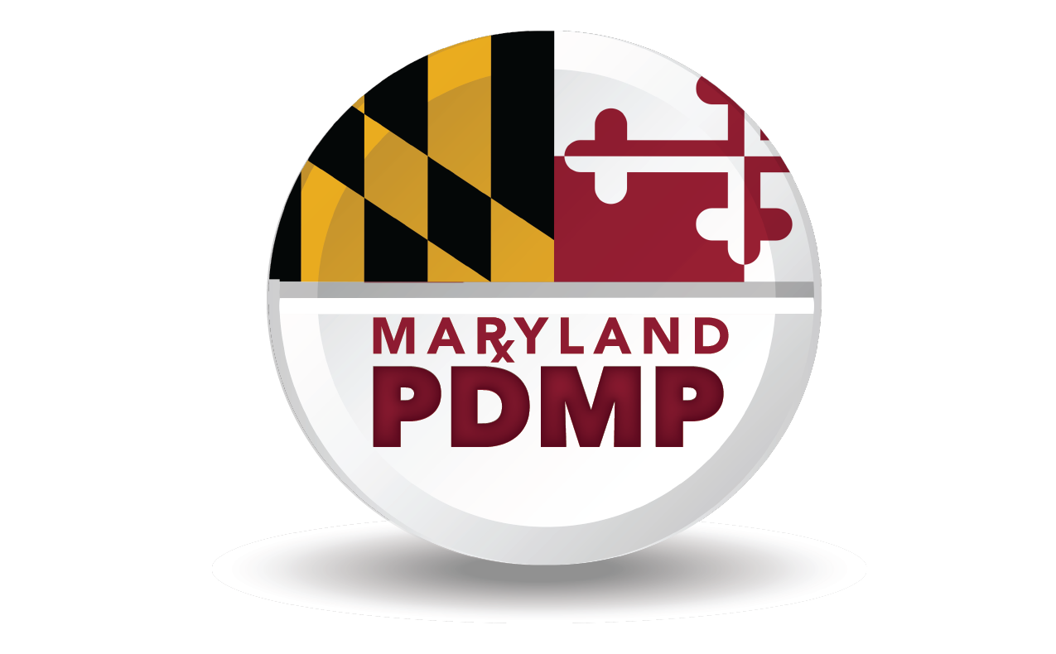
Maryland Prescription Drug Monitoring Program (PDMP)
Data
Notes:
Welcome to the Maryland Prescription Drug Monitoring Program portion of this training. The PDMP is established by Maryland state statute and is administered by Maryland’s Department of Health and Mental Hygiene, Behavioral Health Administration’s Office of Overdose prevention.
All legally authorized clinical users register for and access PDMP data through CRISP, which you have just learned about. Rules around who can access PDMP data and under what circumstances are slightly different than some other CRISP policies, so this section applies to PDMP Data in particular.

Slide 2
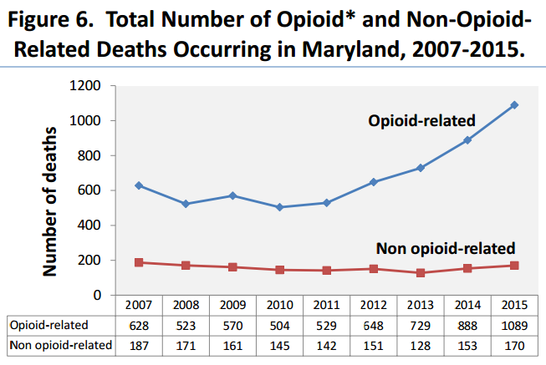
Opioid Deaths in Maryland
Opioid Deaths in Maryland
Source: Drug- and Alcohol-Related Intoxication Deaths in Maryland, 2015
Maryland Department of Health and Mental Hygiene, Vital Statistics Administration
Notes:
Drug deaths now lead all other causes of injury deaths in the US, outstripping both firearm and traffic fatalities.
The number of drug- and alcohol-related intoxication deaths occurring in Maryland increased in 2015 for the fifth year in a row, reaching an all-time high of 1,259 deaths.
Eighty-six percent of all intoxication deaths that occurred in Maryland in 2015 were opioid-related And the number of opioid-related deaths have more than doubled since 2010, increasing 23% between 2014 and 2015 alone.
People who take prescription opioids medically for pain can become dependent on them and begin to misuse them, and some may transition to or supplement with heroin or other substances

Slide 3
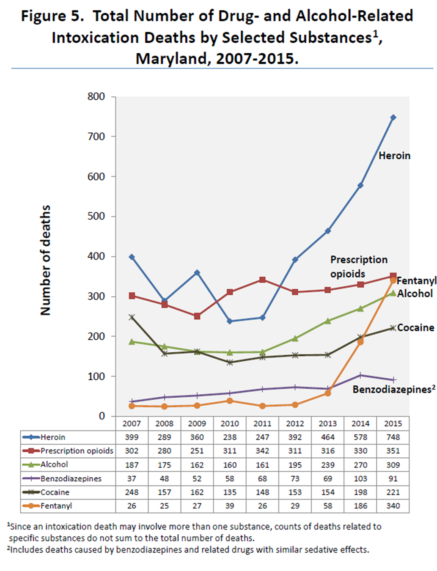
Overdose Deaths: The Changing Landscape
Source: Drug- and Alcohol-Related Intoxication Deaths in Maryland, 2015
Maryland Department of Health and Mental Hygiene, Vital Statistics Administration
Notes:
Among new users of heroin, approximately 75 percent report that they started using the drug after first using prescription opioids
Opioid –related fatalities have been on a steep incline in Maryland, driven in part by large increases in the number of heroin and fentanyl-related deaths.
Most fentanyl-involved overdoses are attributed to non-pharmaceutical fentanyl produced in clandestine laboratories and mixed with, or substituted for, heroin or other illicit substances. Fentanyl is many times more potent than heroin, and greatly increases the risk of an overdose death.
While overdose deaths are by no means the only way to display the impact of the prescription drug epidemic, characterizing the causes of these fatalities in Maryland is instructive, especially from the public health lens.

Slide 4
Maryland PDMP Goals
Assist medical, pharmacy and public health professionals in the identification and prevention of prescription drug abuse
Assist law enforcement and regulatory agencies in the identification and investigation of illegal prescription drug diversion
Promote a balanced use of prescription data that preserves the professional practice of healthcare providers and legitimate patient access to optimal pharmaceutical-assisted care.
Notes:
Almost every state has a PDMP. While there are commonalities between PDMPs, each state’s statute, regulations, and policies do differ.
The first goal of the Maryland PDMP is to assist medical, pharmacy and public health professionals in the identification and prevention of prescription drug abuse
The PDMP is also tasked with assisting law enforcement and regulatory agencies in the identification and investigation of illegal prescription drug diversion
Finally, overarching all of the PDMP’s activities is a goal to promote a balanced use of prescription data that preserves the professional practice of healthcare providers and legitimate patient access to optimal pharmaceutical care

Slide 5
What is the Maryland PDMP
Electronic collection of all Schedule II-V prescriptions dispensed in Maryland
Secure storage of prescription information reported by dispensers
By law, PDMP data are made available to:
✔ Healthcare providers
✔ Public health regulatory agencies
✔ Law enforcement agencies
✔ Researchers
✔ Patients
Notes:
The Maryland PDMP is a secure, state-wide electronic database that contains information on all schedule 2 through 5 controlled dangerous substances, or CDS, prescriptions dispensed in Maryland. By state law, the Program is authorized to disclose collected PDMP data to a number of users, including healthcare providers like yourself.

Slide 6
PDMP as a Clinical Tool
Give healthcare providers real-time, electronic access at the point-of-care to their patients’ complete Maryland controlled dangerous substance (CDS) prescription history to:
Enhance patient-provider communication
Identify aberrant drug using behavior (e.g. receiving multiple CDS Rx from other providers)
Improve providers’ ability to identify possible substance use disorders and refer to appropriate assessment, treatment, and recovery services
Improve providers’ ability to safely and effectively manage patients’ pain and other conditions with CDS pharmacotherapy
Increase confidence in prescribing decisions and patient compliance, and decrease potential for harmful drug interactions
Notes:
The PDMP is a clinical tool for prescribers and pharmacists in the medical care of patients. The program gives healthcare providers real-time, electronic access at the point-of-care to their patients’ complete Maryland CDS prescription history , to
Identify aberrant drug using behavior
Improve providers’ ability to identify possible substance use disorders and refer to appropriate assessment, treatment and recovery services
Improve providers’ ability to safely and effectively manage patients’ pain and other conditions with CDS pharmacotherapy
Increase confidence in prescribing decisions and patient compliance and decrease potential for harmful drug interactions

Slide 7
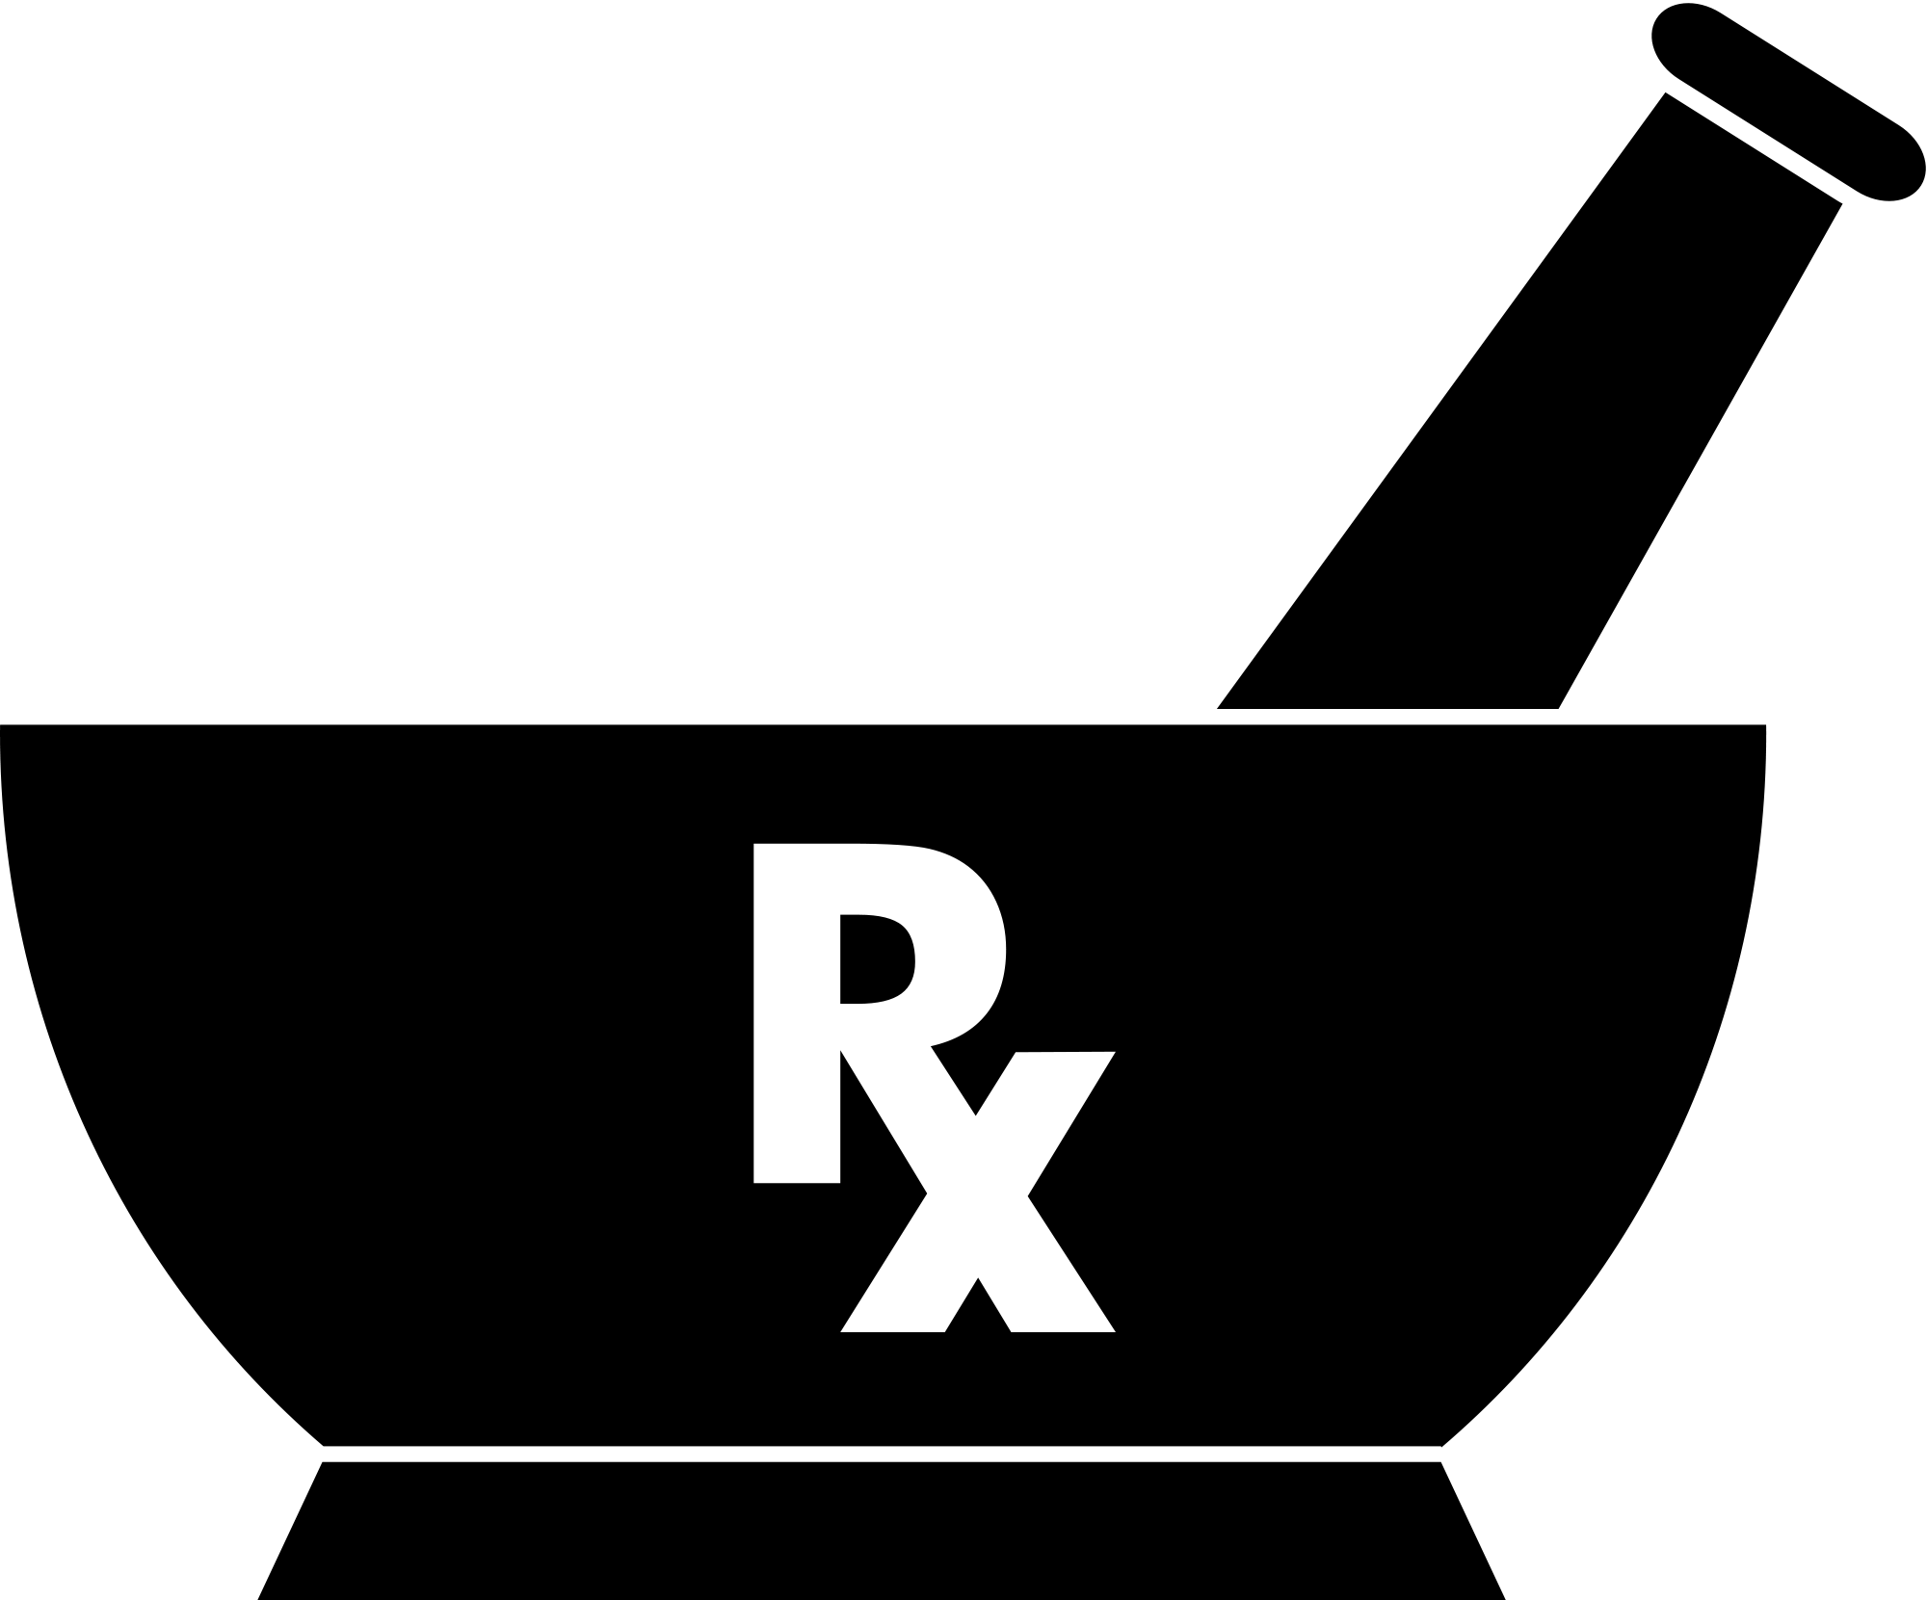
PDMP as a clinical tool - the team!
PDMP
CRISP
CLINICAL USERS
DISPENSERS
Department of Health and Mental Hygiene (DHMH), Behavioral Health Administration (BHA), Office of Overdose Prevention adminsters PDMP
State-designated Health Information Exchange (HIE) registers clinical PDMP users and provides data access within Query Portal and integrations
Includes Prescribers, Pharmacists, Prescriber Delegates, and Pharmacist Delegates
Access data for the medical care of a patient.
Pharmacies (facility or mail-order) and providers who dispense CDS report Schedule II-V prescriptions dispensed in Maryland
Notes:
It takes a collaborative TEAM to combat the opioid epidemic in Maryland.
DHMH has partnered with CRISP to make CDS prescription information available to clincial users. CRISP is the only authorized source for a provider to access PDMP in maryland. Clinical users may access PDMP data through the CRISP Query Portal or through electronic medical record integrations at certain healthcare facilities across the state. CRISP provides user registration and technical support services for clinical users.
The final team member is the dispenser, pharmacies and individuals who are required to report prescription records into the PDMP.

Slide 8
What Data Can Be Found in the PDMP
Records of all Schedule II-V CDS dispensed to patient in Maryland, including identifying information for:
Patient for whom the drug is prescribed, Prescriber, Dispenser, Drug
Includes dispensings by:
hospital outpatient pharmacies
community / retail pharmacies
mail-order pharmacies dispensing to Maryland address
Dispensing practitioners
Dispensers must report to the PDMP within 3 business days of dispensing a prescription
Coming soon…. Daily reporting by dispensers to the PDMP!
Notes:
Within 3 business days of dispensing a medications in Schedule II through V as defined by Federal and State Controlled Substances Laws, Hospital outpatient pharmacies, community retail pharmacies, mail-order pharmacies sending CDS prescription to Maryland addresses, and practitioners authorized to dispense CDS prescriptions MUST electronically report identifying information about the patient to whom the medication was prescribed, the prescriber, the dispenser, and the drug itself.
Upon promulgation of new regulations in the near future, dispensers will be required to report daily to the PDMP, allowing more timely access of data to providers.

Slide 9
What Data Are Not Reported to the PDMP
Statutorily defined exemptions from the requirement for dispenser to report:
Direct administration of CDS to a patient
Drug samples provided to a patient
Records from pharmacies that serve only hospital inpatients
Records from speciality pharmacies that are waivered by the Maryland Board of Pharmacy to serve exclusively assisted living, comprehensive care, and developmental disabilities facilities
Dispensing by a pharmacy to hospice inpatients (if approved by DHMH for a waiver)
Opioid treatment programs (OTPs) / methadone clinics
Dispensing from a veterinary clinic or hospital
Notes:
There are reporting exemptions that are important to know about when viewing PDMP data and making clinical decisions.
Direct Administration of medications and drug samples are not reported to the PDMP. Entities exempted from reporting include pharmacies who serve only hospital inpatients, or who are waivered by the Board of Pharmacy for serving exclusively assisted living, comprehensive care, and developmental disability facilities. Also, with a waiver, pharmacy dispensing to hospice inpatients is exempt from reporting.
Opioid treatment programs, including methadone programs, are also exempt. Federal regulation, 42 CRF Part 2, protects the confidentiality of drug treatment records. Reporting to a state PDMP would put OTPs in violation of this federal regulation and thus dispensing that occurs at these programs are not available in the PDMP.
Veterinarian dispensing is exempt unless a prescription written by a veterinarian is taken to and filled by a retail pharmacy.

Slide 10
Caution in Interpreting PDMP Data
Prescription information is reported to the PDMP by a dispensing pharmacy or practitioner; it does not serve as the official record of a dispensing
PDMP staff and vendors make all efforts to ensure data are complete and accurate, reports may contain omissions or errors
If you or your patient has concerns about possible data inaccuracies:
Contact the dispenser to verify whether the prescription information was reported to the PDMP accurately (The original prescription retained by the dispenser serves as the official record)
If an error is confirmed by the dispenser, please contact the PDMP administrator at DHMH by email at dhmh.pdmp@maryland.gov or call 410-402-8686
Notes:
We advise that some caution should be taken when interpreting PDMP data.
PDMP data are records of dispensing as reported, and should not be considered the official record of a dispensing transaction. Only the original prescription can serve as the official record.
Although all efforts are made to ensure data accuracy and completeness, reports may contain errors or omissions.
If you have questions or concerns about data found or not found within the PDMP records, please first contact the dispenser to verify whether PDMP data viewed in CRISP matches the dispenser’s records and the original prescription.
If a dispenser confirms an error or omission in PDMP data, please then contact the PDMP administration by email at dhmh dot pdmp at maryland dot gov (dhmh.pdmp@maryland.gov) or by phone at 410-402-8686.

Slide 11
PDMP Clinical Users and Terms of Use
Prescribers: authorized to prescribe CDS in Maryland
E.g. MD, DO, DDS, DMD, NP, PA, DPM, DVM
May access PDMP data in connection with the medical care of a patient
Pharmacists: authorized to disepnse CDS in Maryland
May access PDMP data in connection with the dispensing of a CDS medication
Clinical access to PDMP data through CRISP is for treatment purposes, independent of the requirement for dispensers to report data to the PDMP
Clarification on PDMP vs Clinical and Encounter Data
PDMP access is available to all who meet the definition of prescriber or pharmacist. Clinical data access may be limited based on organization affiliation and CRISP policies.
Notes:
Clinical users authorized to access PDMP data are grouped into 3 categories, prescribers, pharmacists, and delegates. Prescribers are any practitioner authorized by law to prescribe CDS in Maryland. Pharmacists are individuals authorized to dispense CDS in maryland.
This terminology may differ slightly from what is used to describe clinical user access to other CRISP data feeds.
delegate.
The follow are the terms of legitimate access and use of PDMP data:
Prescribers and licensed healthcare practitioners delegated by a prescriber may access PDMP data in connection with the medical care of a patient

Slide 12
Delegation of Access Authority
Delegates:
E.g. RN, LCSW, MA, pharmacy tech, office manager / assistant
May access PDMP data as authorized by a delegating Prescriber or Pharmacist
PDMP-registered CDS prescribers and pharmacists may delegate staff to obtain CRISP user accounts and query PDMP data on their behalf.
Delegates may include:
licensed practitioners without prescriptive authority
non-licensed clinical staff that are employed by, or under contract with, the same professional practice or facility where the prescriber or pharmacist practices
Notes:
Starting October 1, 2016, delegates can either be licensed healthcare practitioners without individual prescriptive authority, or other staff members who are employed by or under contract with the same professional practice as the prescriber or pharmacist. Prescriber Delegates and Pharmacist Delegates may access PDMP data on behalf of a delegating Prescriber or Pharmacist
See the PDMP and CRISP websites for more information about delegate roles.

Slide 13
Legal: Unlawful Access & Use
Criminal Penalties
A person who knowingly discloses, uses, obtains, or attempts to obtain by fraud or deceit PDMP data in violation of Maryland PDMP statute (Health-General Article §21-2A, Annotated Code of Maryland) shall be guilty of a misdemeanor.
Administrative Sanctions
A prescriber or pharmacist who knowingly discloses or uses PDMP data in violation of Maryland PDMP statute (Health-General Article §21-2A, Annotated Code of Maryland) shall be subject to disciplinary action by the appropriate licensing board.
PDMP data are confidential, privileged, not subject to discovery or subpoena in civil litigation and are not public records.
Notes:
A person who knowingly discloses, uses, obtains, or attempts to obtain by fraud or deceit PDMP data in violation of Maryland PDMP statute shall be guilty of a misdemeanor
In addition, A prescriber or pharmacist who knowingly discloses or uses PDMP data in violation of Maryland PDMP statute shall be subject to disciplinary action by the appropriate licensing board
HIPAA applies to PDMP data, but there are additional legal considerations you should be aware of. PDMP data are confidential, privileged, not subject to discovery or subpoena in civil litigation and are not public records.

Slide 14
Legal: Redisclosure of PDMP Data
When PDMP data redisclosure is allowed…
Redisclosure of PDMP data by a Prescriber or Pharmacist is not a violation of the Maryland PDMP statute (Health-General Article §21-2A, Annotated Code of Maryland)
Only if the following are met:
Redisclosure is made to another licensed health care professional
Solely for treatment purposes
In a manner otherwise consistent with State and federal law governing the security and confidentiality of protected health information and personal medical records
Notes:
The release of PDMP data by a prescriber or pharmacist to another licensed healthcare professional solely for treatment purposes and in a manner otherwise consistent with state and federal law IS protected under the PDMP statute.

Slide 15
When You Find Something Unexpected in the PDMP
Talk to your patient about appropriate medical care and management
Screen for substance use disorders (SBIRT)
Consult existing guidelines on safe prescribing for acute or chronic pain
Consider referring patient to pain management specialist
Consider referring patient to specialized substance use disorder treatment facility or specialist
Consider prescribing naloxone to patients known to be taking opioids
Visit the DHMH PDMP website and click on Clinical Resources
Notes:
A main goal of the PDMP is balancing appropriate management of specific conditions for which CDS medications may be indicated with the risks associated with controlled substances, including addiction and overdose.
As you begin accessing PDMP data you are bound to find information of note that may impact the type of care you choose to provide to your patients. The Maryland PDMP recognizes the need to equip clinical users with resources to address issues uncovered through viewing a patient’s PDMP data.
Aberrant drug-taking behavior, formerly called drug seeking, may be observed through red flags within the PDMP data, such as early refills, overlapping prescriptions, or multiple similar prescriptions from different prescribers.
Red flags for overdose risk may also be apparent in the PDMP. For example, high dose opioid prescriptions or concurrent prescriptions for opioid and benzodiazepines.
Talk with your patient about what you see in their PDMP Data and consider whether screening for a substance use disorder, referral to an applicable specialist, or a prescription for naloxone may be warranted.
There are many resources available which may be of help to you. To access these resources, go to the Clinical Resources tab on the Department of health and mental hygiene’ s PDMP page.

Slide 16
General and Policy questions about Maryland PDMP Website: www.marylandpdmp.org Email: dhmh.pdmp@maryland.gov Phone: 410-402-8686 Maryland Crisis Hotline 1-800-422-0009
PDMP Key Contacts
Notes:
For more information about the PDMP, including legal or policy questions, and clinical provider resources, please visit the Department of Health and Mental Hygiene’s PDMP web page, or email or call the Program.

